Slide 1


Travelogues & Linked Data
<Martin Krickl> (<Österreichische Nationalbibliothek>)
<AG BIBFRAME>
<Universität Wien>

Slide 2







Notes:
Interdiscplinary project
Computer Science
Historians

Slide 3
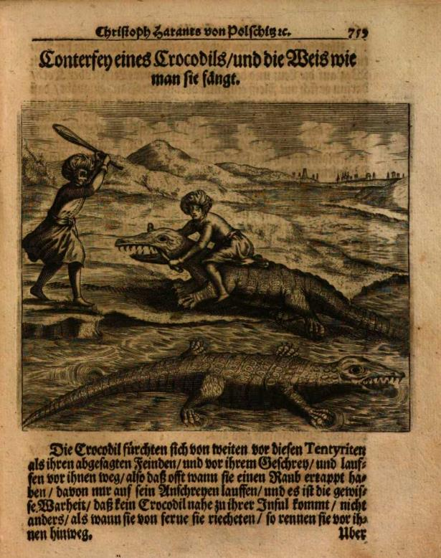
TRAVELOGUES | Motivation
A relevant historical source
Large-scale digitization offers new possibilities
Notes:
A relevant...
A lot of research on this genre
Gives insights into people’s thoughts, experiences, expectations (their own, of the ones still at home -> their audience)... “really shines a light on history”
Insights into historic dimension of the perception of the Other – probably still influences us today
Very heterogeneous
Travelers (pilgrims to merchants, from scholars to diplomats and early tourists), their destinations and motives, modes of writing
Different target audiences
Past research: has been very limited in terms of corpus size
Could develop into European-wide “bestsellers” and substantially shape the contemporary and future perception of other regions as well as their inhabitants
Large scale...
Digitization and text-mining techniques can exponentially increase the amount of text analysed
State of the art on a new domain!

Slide 4
Travelogues | Research Goals
Semi-supervised creation of a corpus
Enrichment of meta data / as much LOD ap
Perceptions of the other & discourses of the Orient
Notes:
Semi-supervised...
Characteristics and commonalities
Relationships to other texts
Important: will not cover all the travel reports (some are not digitized; we will probably not find all)
Enrichment...
Author information (name, origin, confession etc.)
Relation between different texts and authors (plagiarism, inspiration etc.)
Info from the texts like visited locations, persons/peoples mentioned etc.
Perceptions...
Key terms and the associated meanings/their usage over time
Images of religions
Relations to modern images (people(s), religions, customs... Anything else)

Slide 5
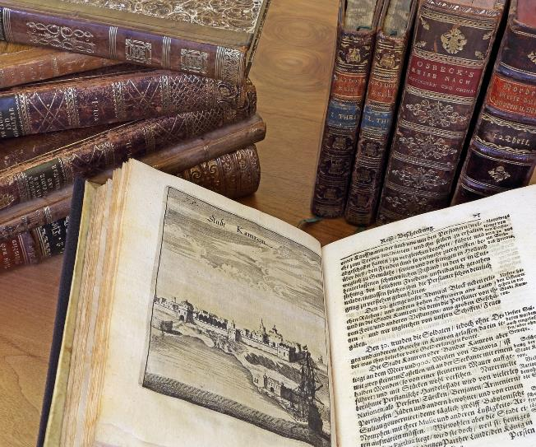
Travelogues | data set
600.000 digitalisierte historische Drucke der Erscheinungsjahre 1500-1877 (ABO)
Circa 3500 Reiseberichte
OCR verfügbar (Googlebooks)
Da fehlerhaft Task OCR-postcorrection
Von “basalen” Metadaten zu “quality-data”
Niemals datacleaning und dataenrichment unterschätzen
Notes:
Inventory of the Austrian National Library (Habsburger collection)
Focus on German-language publications
Timeframe: 1500 due to printing, 1875 to avoid copyright problems
OCR done through Google Books project; word-level
Meta data in part from 19th century, different standards etc. make it difficult

Slide 6
Quality Data?
Big data – smart data und “big smart data” als Währung der Bibliotheken
[Christof Schöch: Big? Smart? Clean? Messy? Data in the Humanities. In: Journal of Digital Humanities 2.3 (2013)]
Transformationen der Funktionen von Bibliothekskatalogen – Vom indexikalischen Nachweissystem zum Hub für “quality-data”
“Quality data” as “trading good” – “weight – trust and comparability via IDs”
[Raphaël Lapôtre: Library Metadata on the wen: the example of data.bnf.fr. In: JLIS.it 8.3. (2017)]
Was heißt “quality data” für wen und was heißt “quality cataloging”?
[Karen Snow: Defining, Assessing, and Rethinking Quality Cataloging. In: Cataloging & Classification Quarterly 55.7-8 (2017), 438-455]

Slide 7
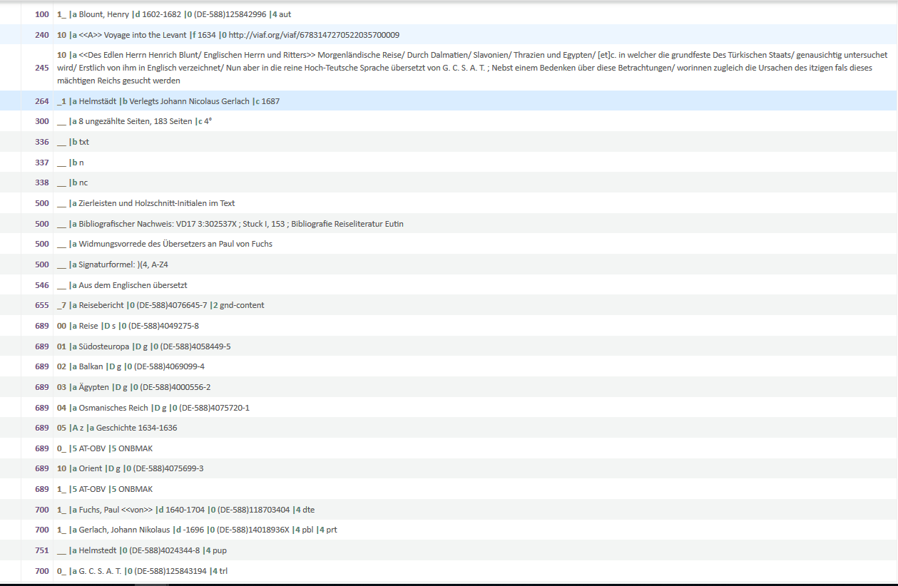
Quality Data in travelogues

Slide 8
Travelogues Data | ONB-LOD
Linked Open Data Strategie-Gruppe an der ONB [Georg Petz]
Bereitstellung der SRU und OAI-PMH-Schnittstellen über labs.onb.ac.at
Evaluation der Ausgabeformate im Rahmen des Travelogues-Projektes:
Ausgaben in sekundären Format (CSV, Excel) über ein JupyterNotebook auf Basis des originären Eingabeformates MARC21.
Testsieger BIBFRAME: Minus jedoch Schlagworte und Hierarchien
Unbrauchbar: RDF/ RDA ; DC ; JSON-LD
JSON-LD für Corpuspublikation aus SACHA MODS

Slide 9
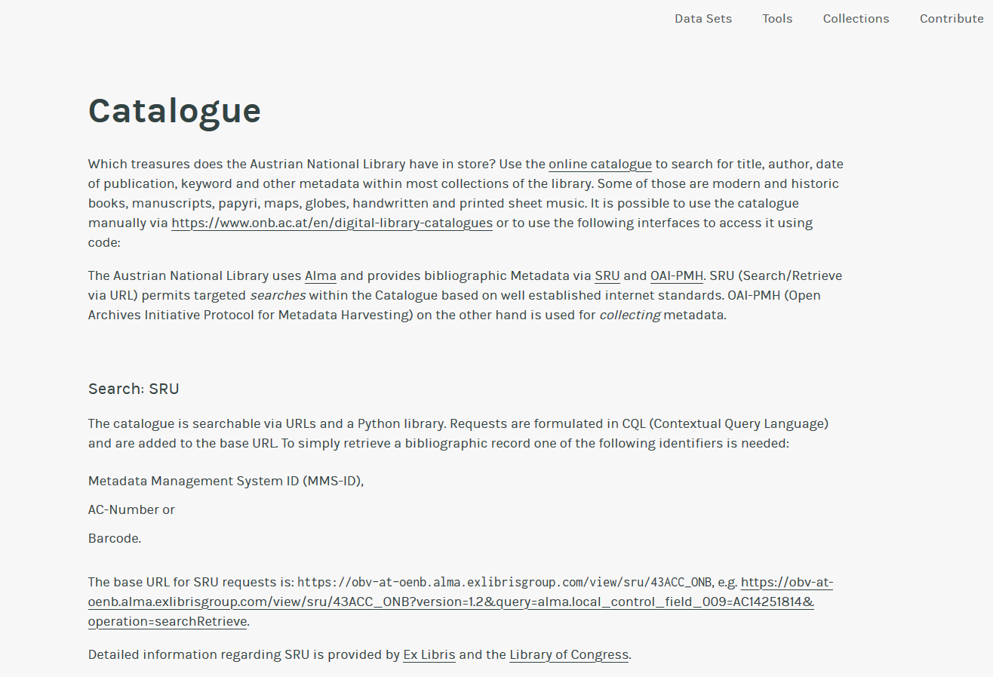

Slide 10
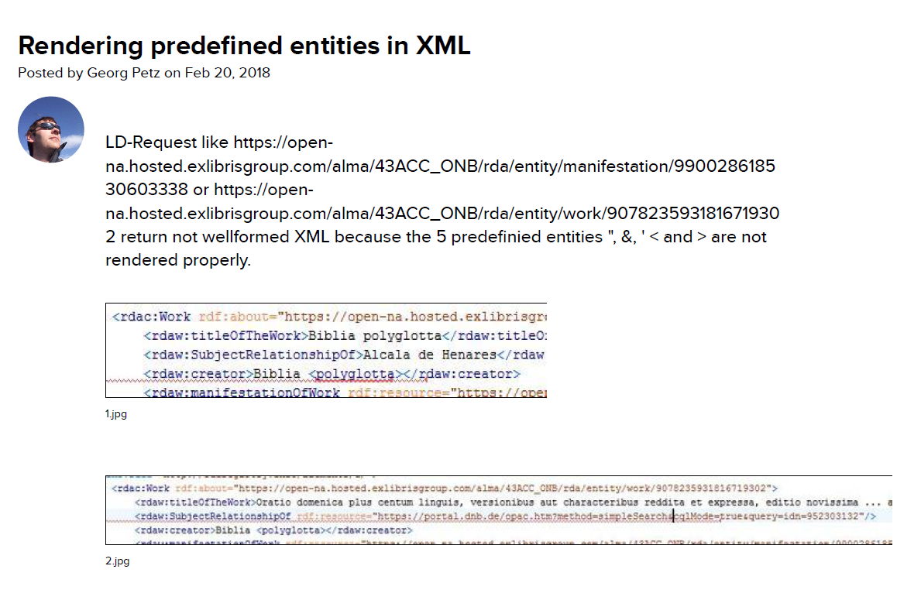

Slide 11
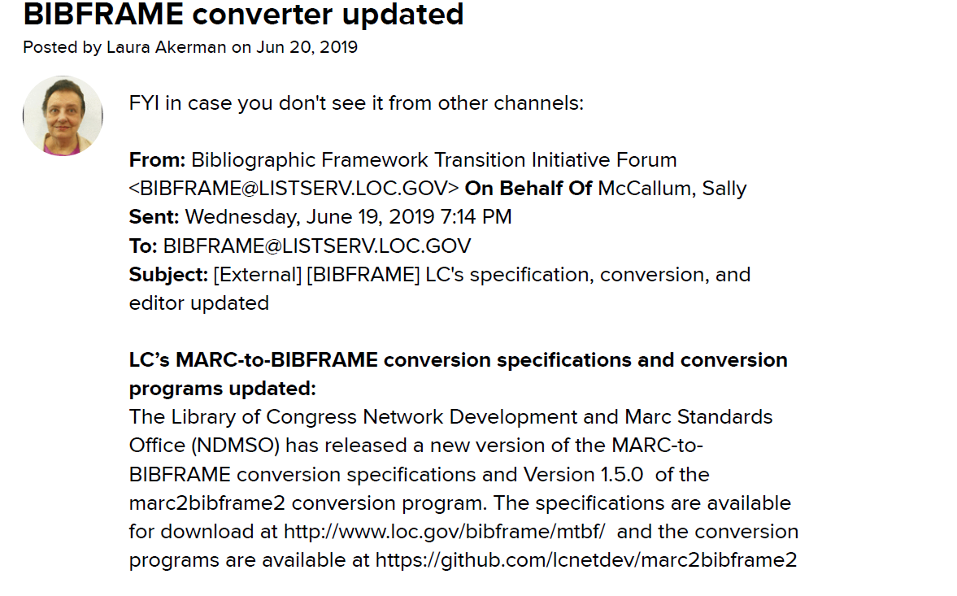

Slide 12
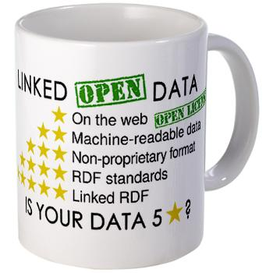
Evaluation of Linked Open Data
Wo stehen wir im ÖBV? Wo stehen einzelne Bibliotheken?
“Linky MARC” als Zwischenstufe?
[Richard Wallis: MARC and beyond: our three Linked Data choices. IFLA WLIC 2018]
Hat RDF immer noch diese “Exklusivität”?
Welche Probleme gilt es im ÖBV zu addressieren?
[Bsp. Identifier, Integration von URIs ; Ausweisung von LD im OPAC]
Burners-Lee (2009) www.w3gorg/DesignIssues/LinkedData

Slide 13
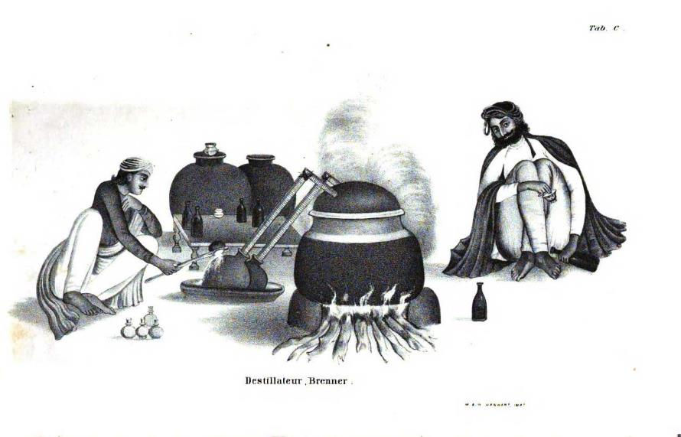
LOUD Quality-Data FROm and FOR?
Welche Quellen haben für welche Communities (User) welche Relevanz?
[Bsp. Wikidata: Wikidata für Bibliotheksdaten oder Bibliotheksdaten für Wikidata?]
Ist das Format sekundär? Welche Anforderungen stellt die Forschungscommunity?
Wie kann “quality data” für und mit domänenspezifischen Nutzern generiert werden? [Know your community!]

Slide 14
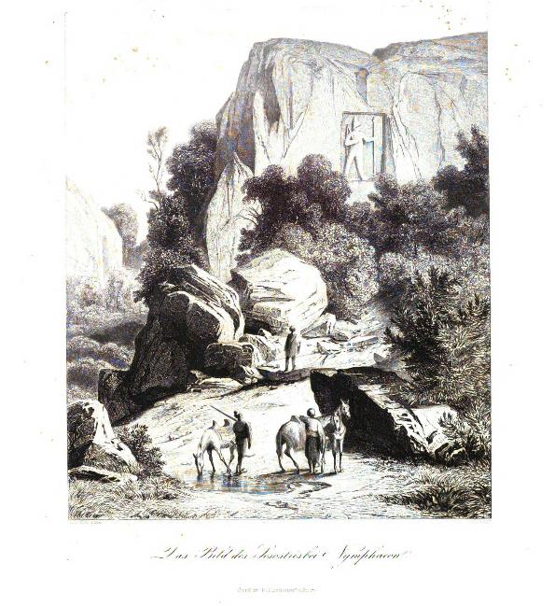
LINKEN OPEN USABLE Quality Data
Ein langer steiniger Weg?

Slide 15
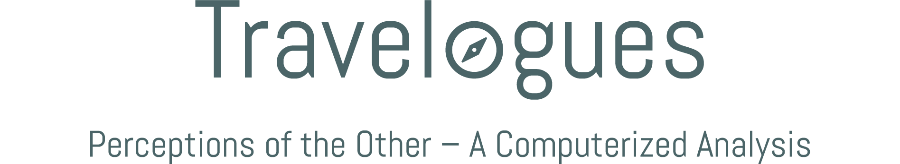
www.travelogues-project.info
<name>@<email>.at

